Slide 1
Ancestry Revealed
A Way to Use Your Ancestry Subscription and FamilyTreeMaker
with a Client Account

Slide 2
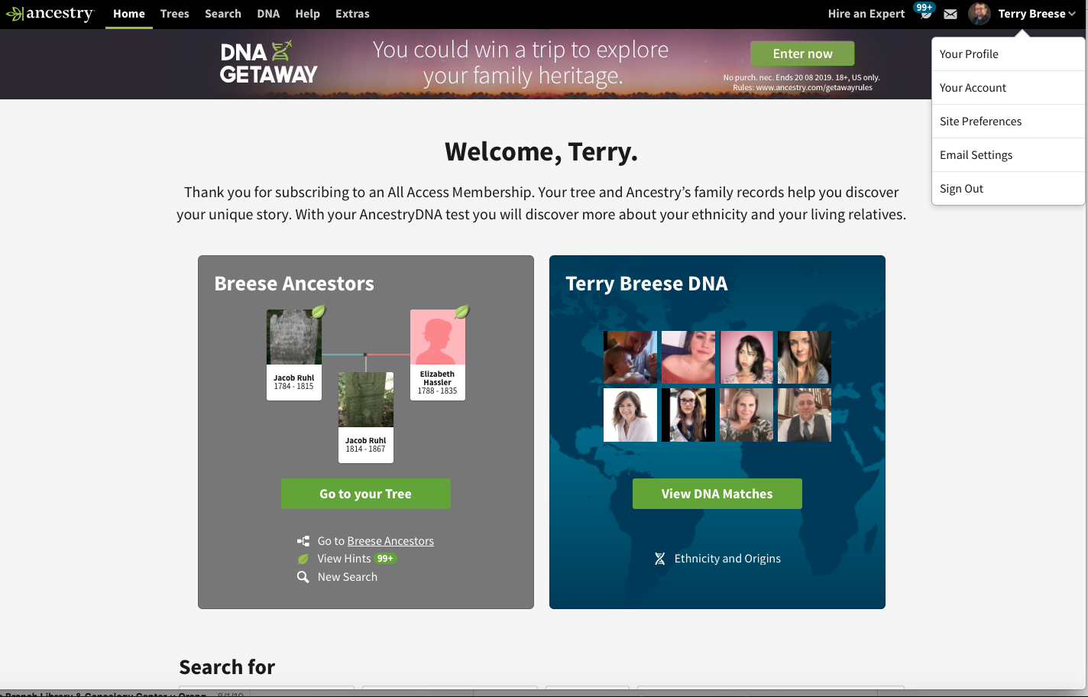
If, like me, Ancestry automatically opens to your home page, sign out of your own account.

Slide 3
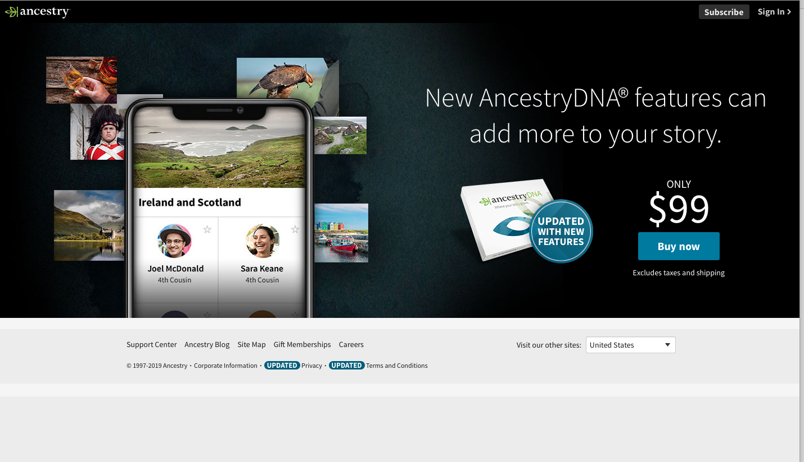
Click on “Sign In”
“Subscribe” will get you the screen to choose a paid subscription.

Slide 4
You want the “Sign Up Today for Free”
Clicking in the white space will usually clear away the list of your accounts.

Slide 5
You want the “Sign up today for free.”

Slide 6
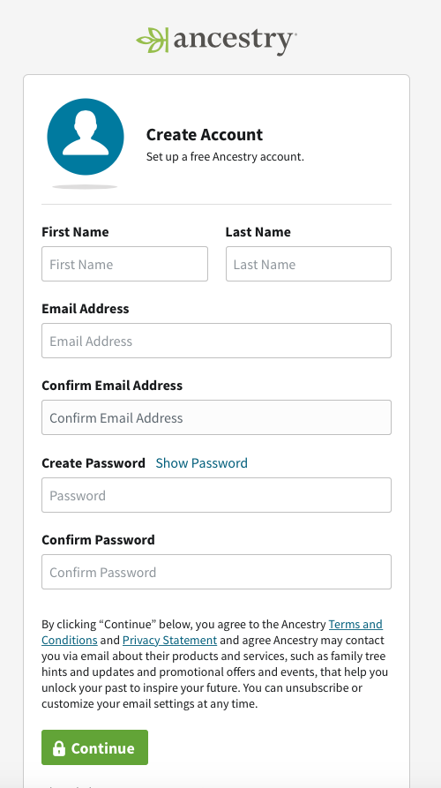
Fill in the information for the client
Email address will become the login
Have the client choose a password.
Write down the email address and password in your notes!
Continue

Slide 7
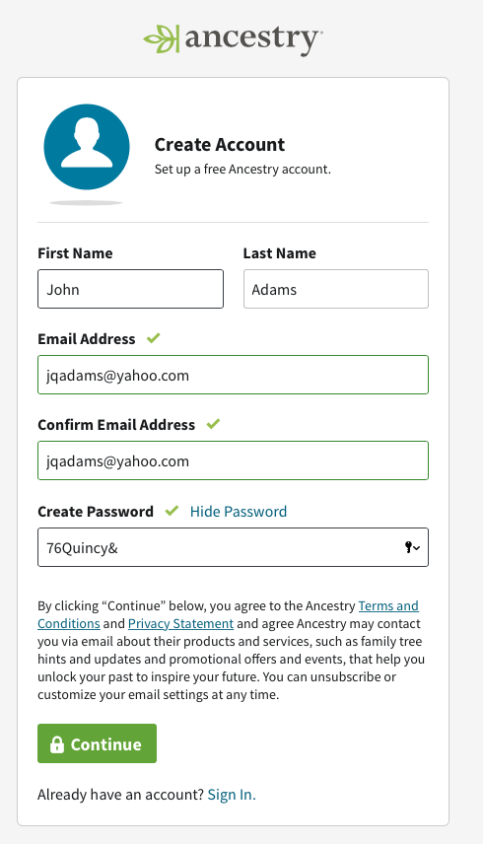
Fill in the information for the client
Email address will become the login
Have the client choose a password.
Write down the email address and password in your notes!
Continue

Slide 8
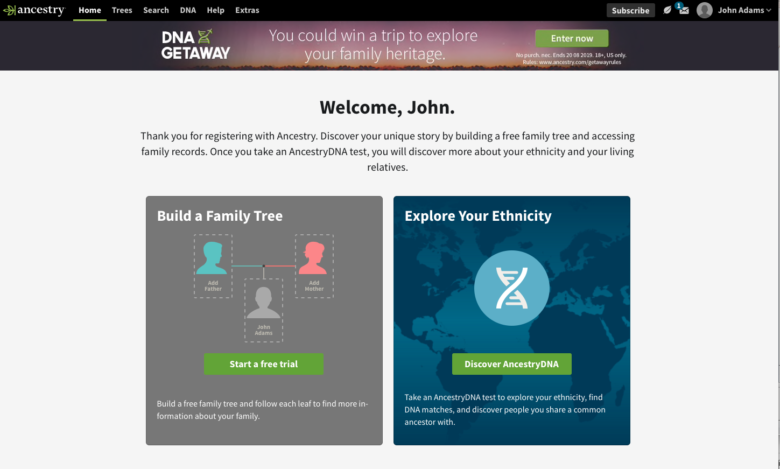

Slide 9
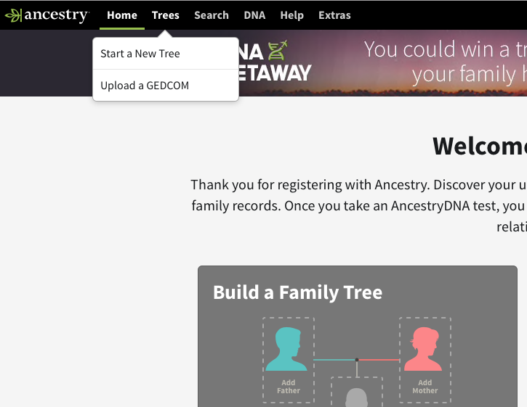
Select “Trees” and “Start a New Tree”
DO NOT SELECT “Start a Free Trial”. It’s an invitation to get a subscription.

Slide 10
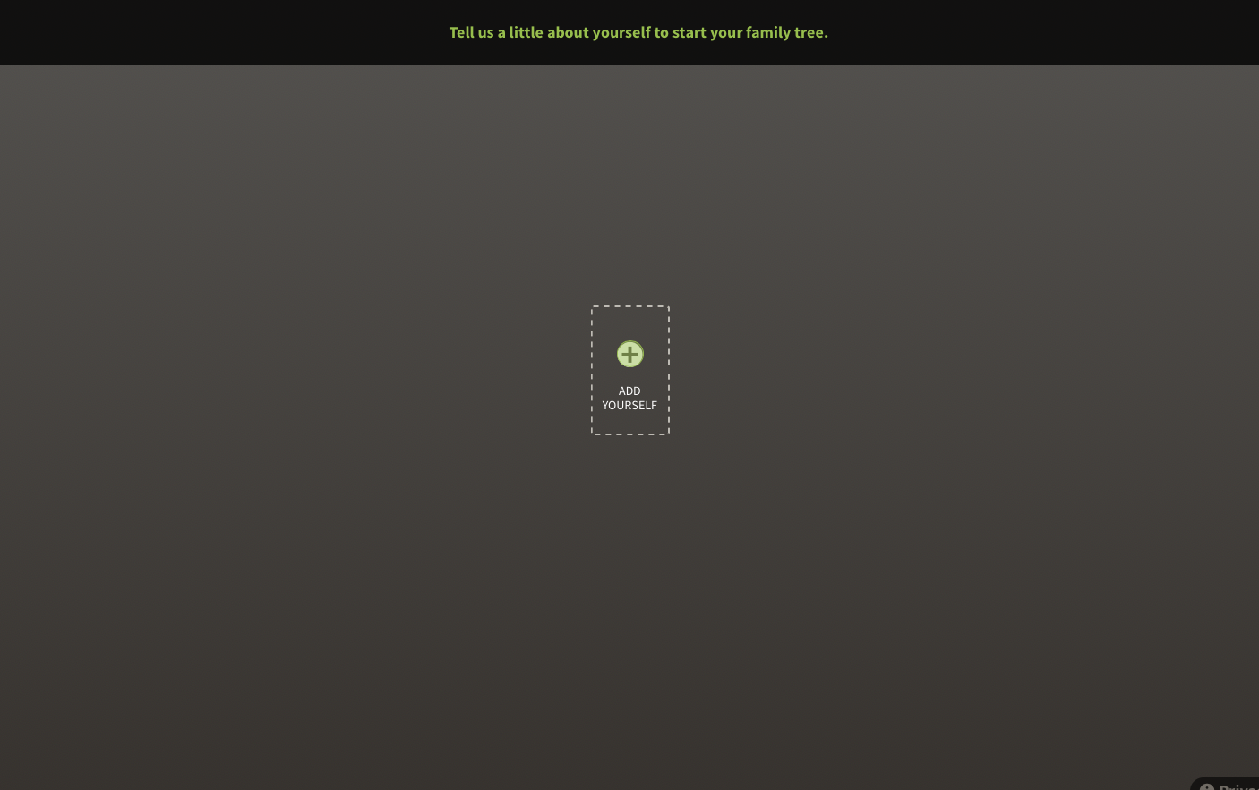
Start with the client and his or her parents.

Slide 11
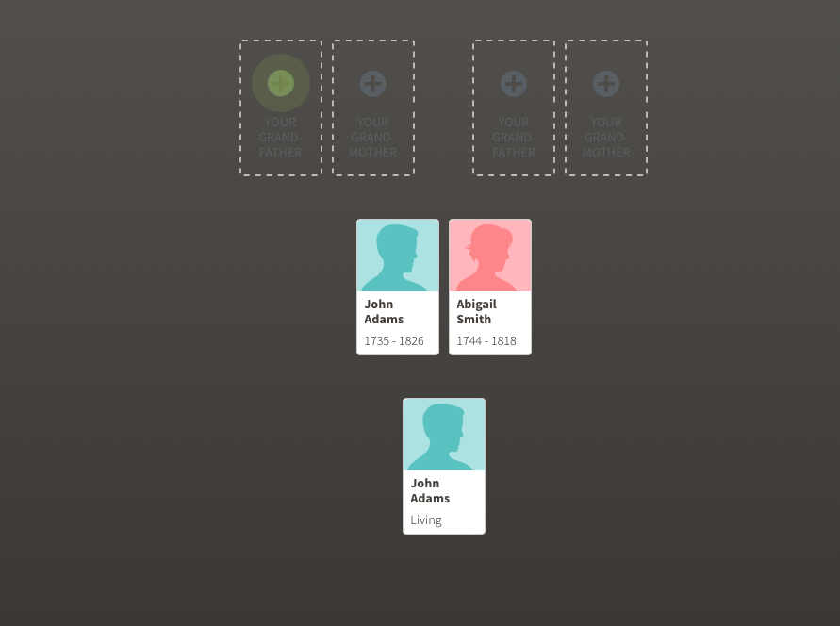
This is enough for now.

Slide 12
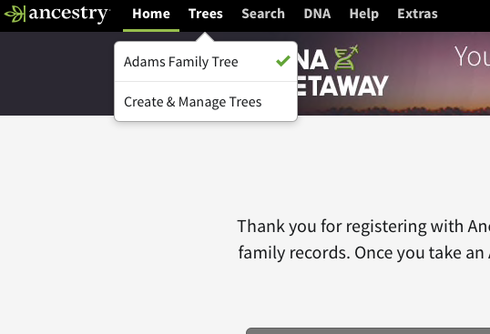
The “Adams Family Tree” is now available.
Select “Create & Manage Trees”

Slide 13
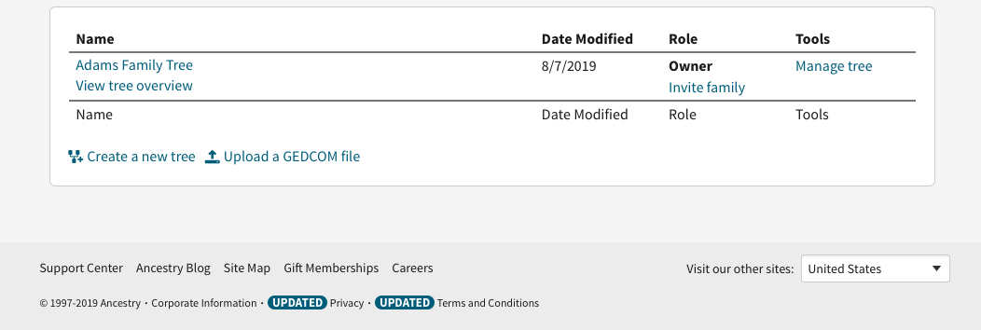
Select “Manage Tree”

Slide 14
Select “Sharing”

Slide 15
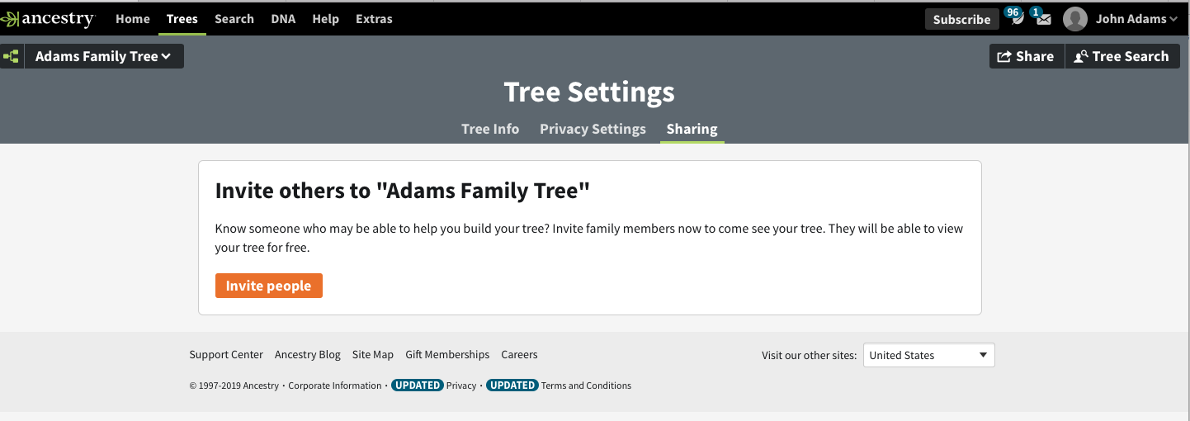
Select “Invite People”

Slide 16
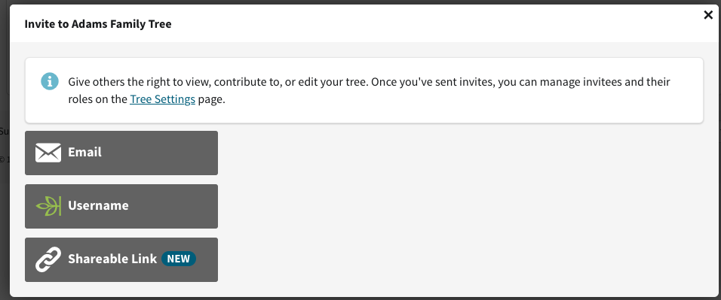
Select “Username”
I assume you know your own username

Slide 17
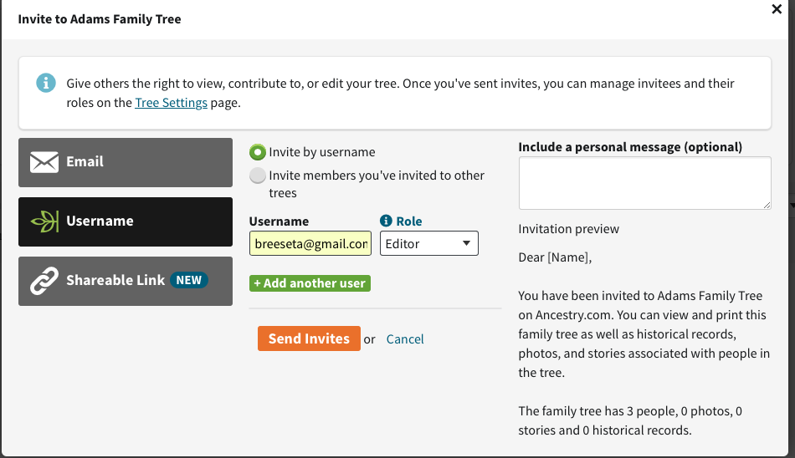
Enter your username and give your role as “Editor”
“Send Invites”

Slide 18
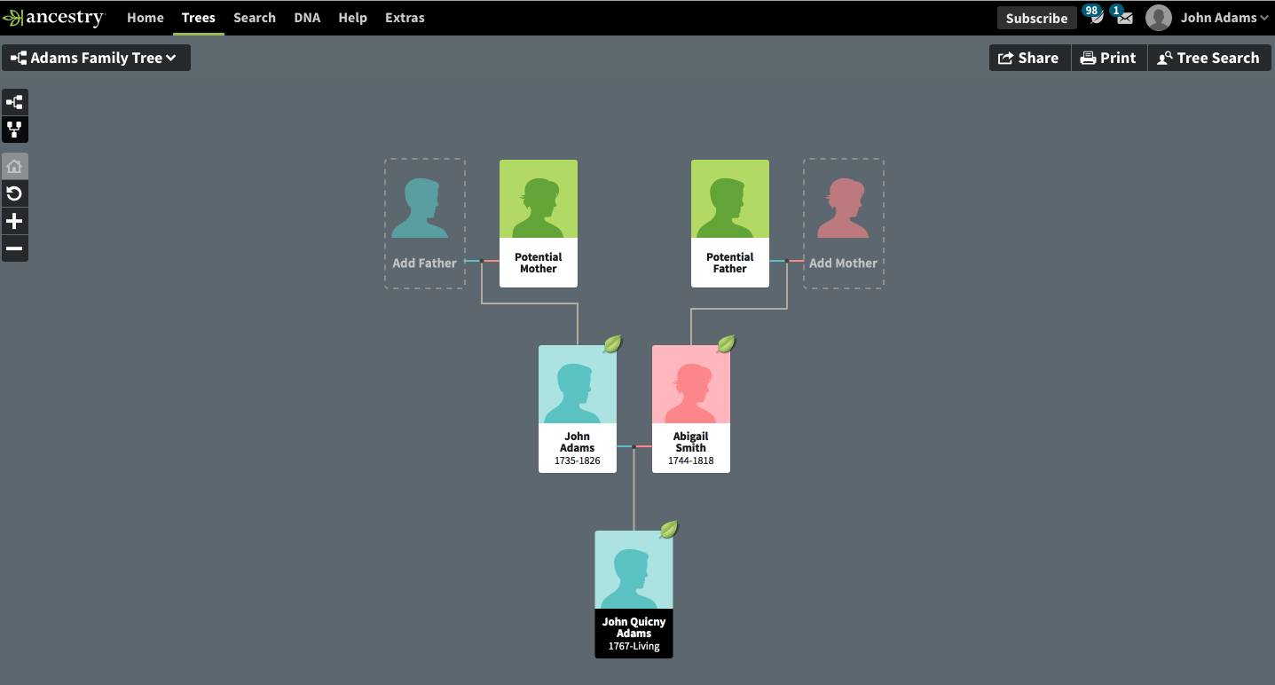
Logout of “John Adams” and Login to your own account. You can also just open another window and log in.
The new family tree may not show up on your list of trees until the next day

Slide 19
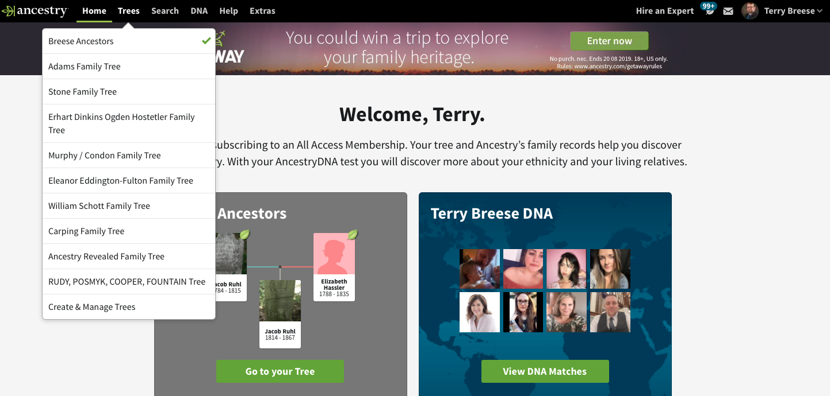
The new family tree may not show up on your list of trees until the next day.
But you should receive an email pretty quickly inviting you to the newly created tree.

Slide 20
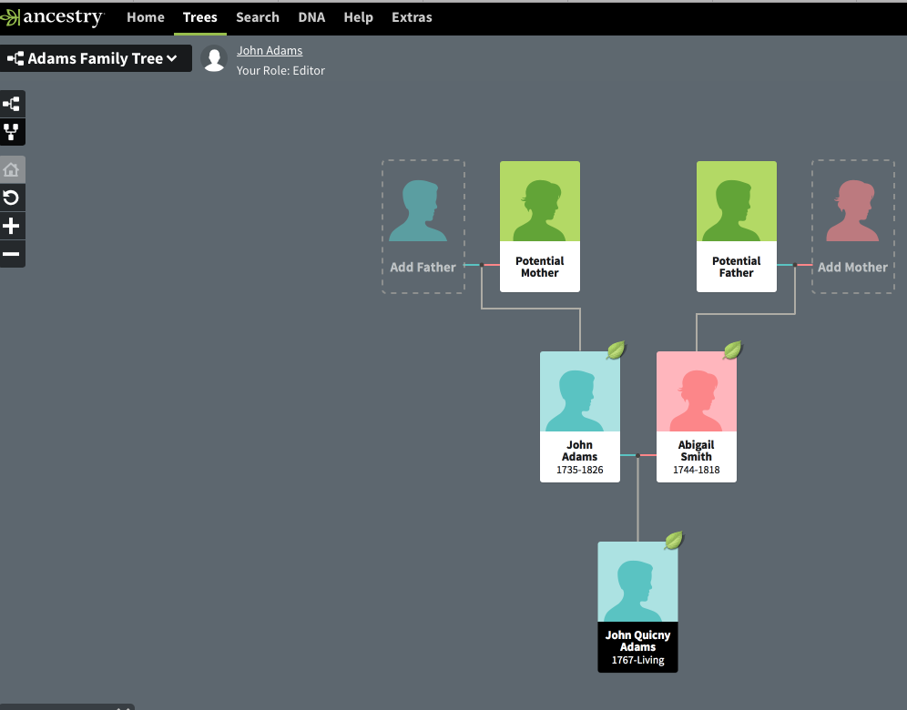
The new family tree may not show up on your list of trees until the next day.
But you should receive an email pretty quickly inviting you to the newly created tree.

Slide 21
Using FamilyTreeMaker
By using the client’s username and password, you can bring the Ancestry,com tree you’ve just created for them into your FamilyTreeMaker software.
You will be able to use FTM’s publishing and other features.
You will be able to sync any changes you make in FTM back to the Ancestry.com tree.
And the client remains the owner of the Ancestry.com tree afterwards.

Slide 22
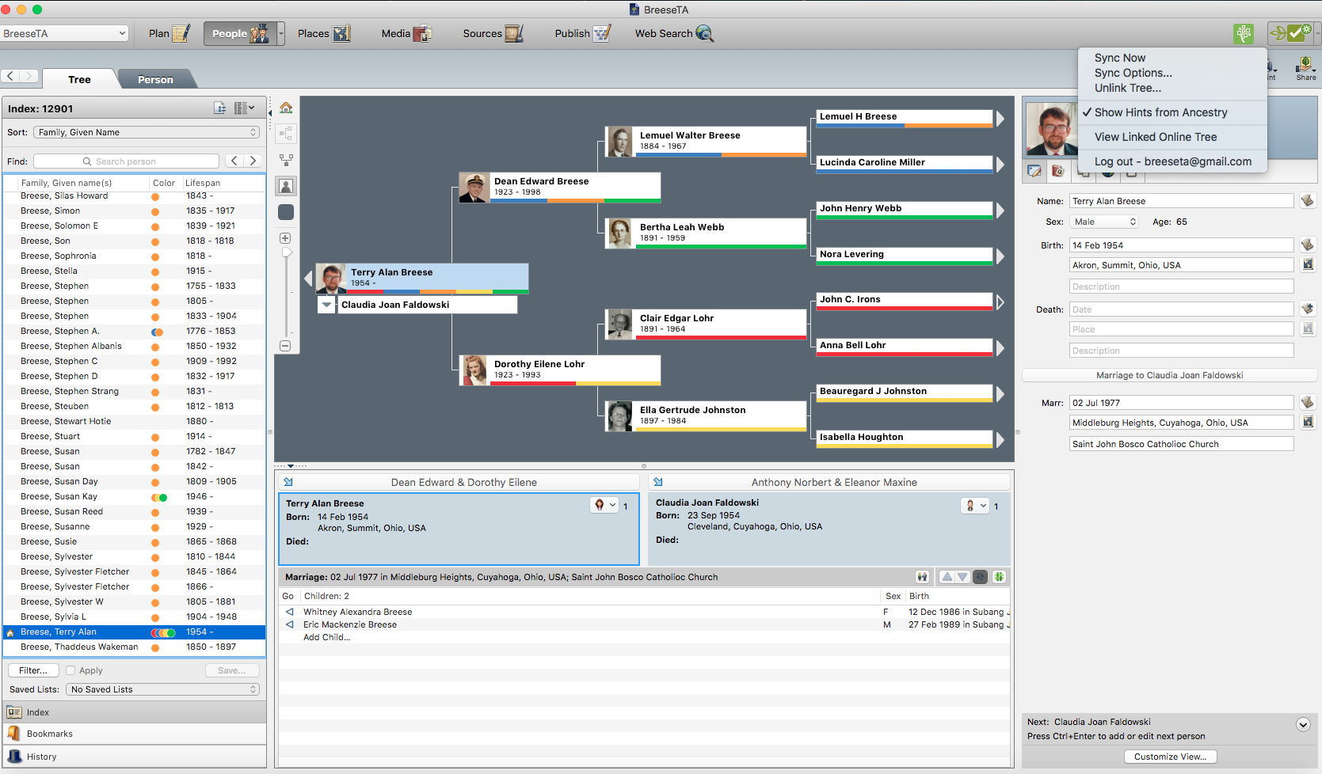
You need to “Log out” as yourself and log in as the client.
You did write down their username and password, right?

Slide 23
You need to “Log out” as yourself and log in as the client.
You did write down their username and password, right?

Slide 24
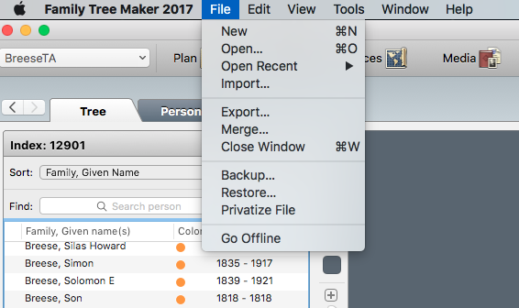
Under “File” select “New”

Slide 25
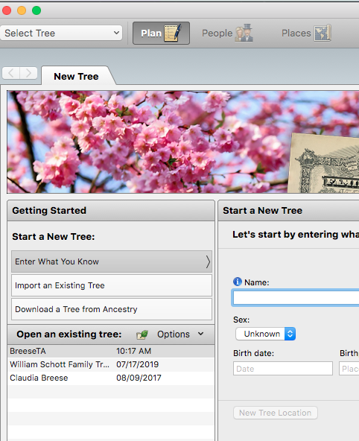
Select “Download a Tree from Ancestry”

Slide 26
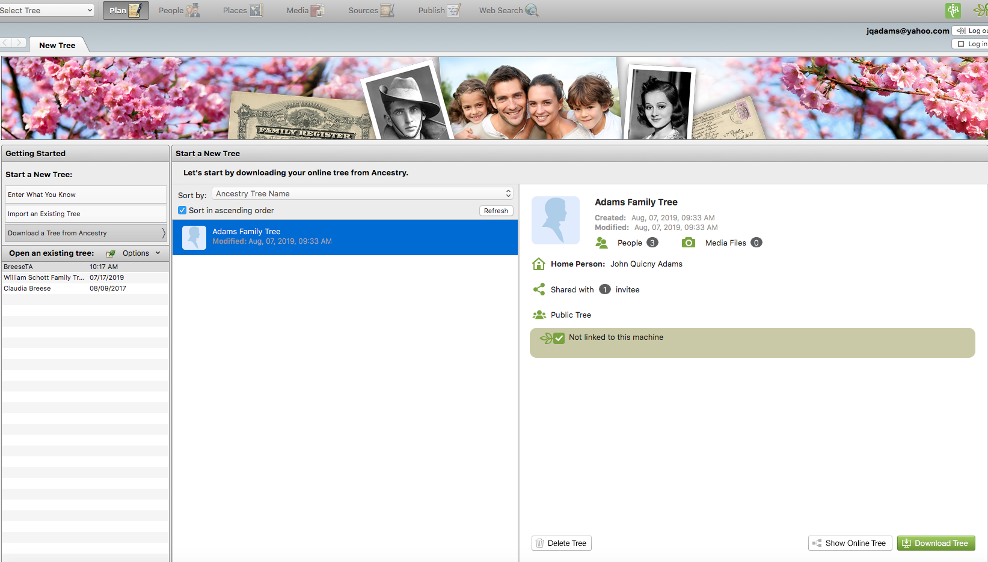
You should see only the tree you created for the client.
Select “Download”

Slide 27
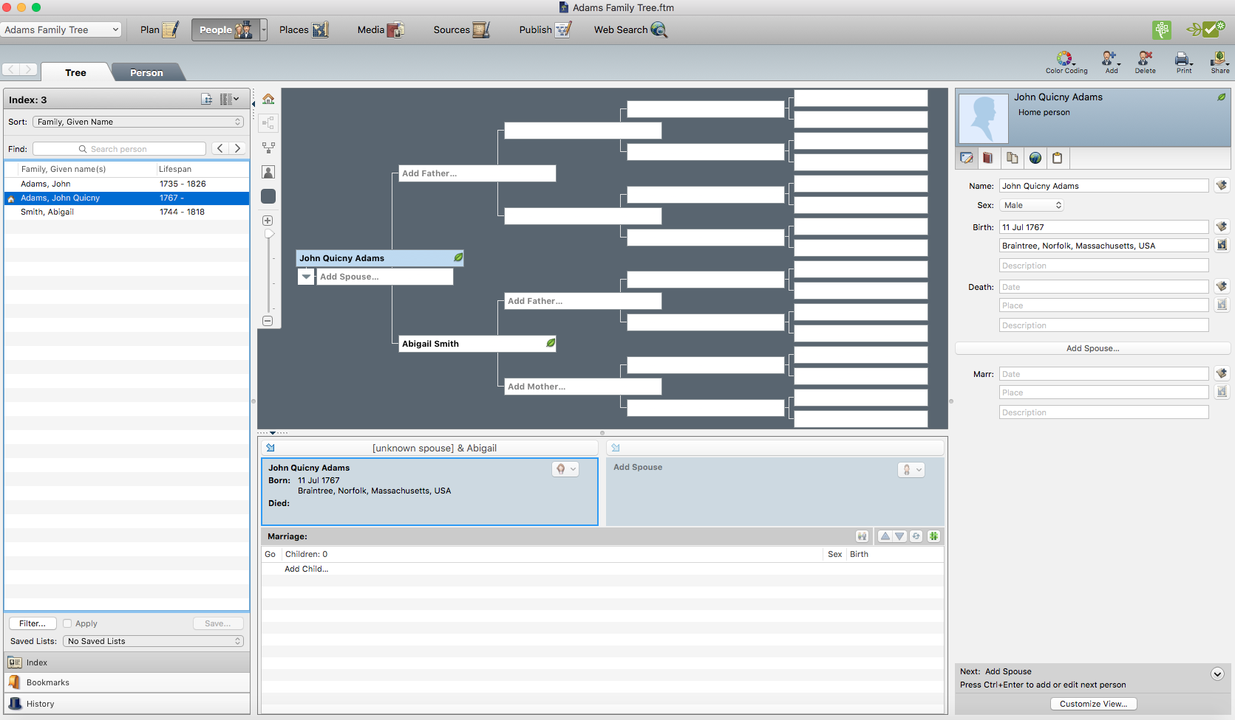

Slide 28
What You Can and Can’t Do
You CAN
Research using any accesses you have on Ancestry
Directly save any Ancestry hints to the client’s tree
Sync the Ancestry tree and the FTM trees (as long as the “weather” is green).
Use FTM publishing features to create reports and charts.
Create a GEDCOM.
Backup the FTM tree and any charts using the “one-page pdf” function to a flash drive.

Slide 29
What You Can and Can’t Do
You CAN’T
Directly save what you find in Find-a-Grave, Newspapers.com, or Family Search to the client’s Ancestry tree. Because you are in your account, you can only save to your trees, not those you edit.
You will have to create a folder on your desktop for the client’s tree and save research results to your computer. Then you can put those documents into Ancestry or FTM.

